Slide 1

Effectiveness of Monetary Policy Transmission in India
DEVI AHILYA VISHWAVIDYALAYA, INDORE
SCHOOL OF STATISTICS
(SESSION- 23-27)
An Econometric Analysis of Repo Rate, Bank Lending
Rates, and Inflation
Guided By
Dr Arpita Lakhre
(Assistant Professor )
Presented By
Tushar Dey
ST4A2305
B.Sc. Applied Statistics and Analytics(Vth Semester)

Slide 2
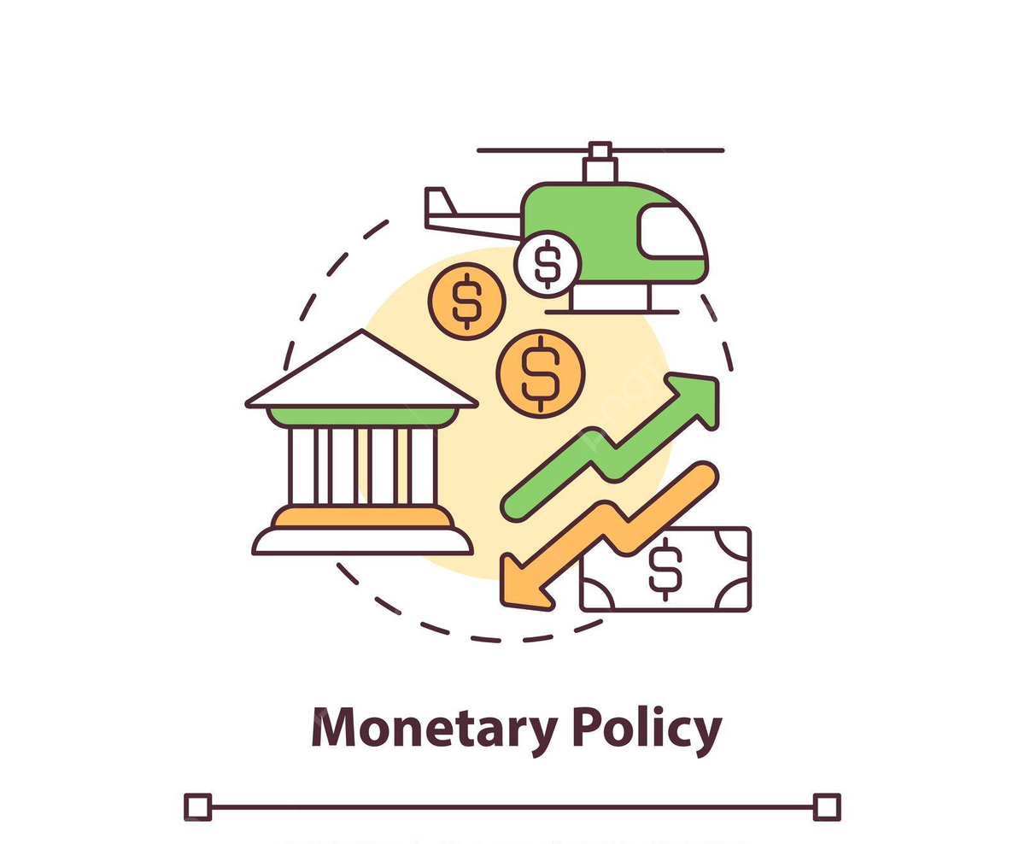
Introduction
Monetary policy plays a central role in macroeconomic stabilization by influencing interest rates, credit conditions, and inflation.
In India, the Reserve Bank of India (RBI) conducts monetary policy primarily through changes in the policy repo rate, with the objective of maintaining price stability while supporting economic growth.
The effectiveness of monetary policy, however, depends not only on policy decisions but also on the strength and speed with which these decisions are transmitted to the broader economy.
Understanding the monetary policy transmission mechanism is therefore crucial for evaluating the success of interest-rate-based policy frameworks.

Slide 3

Variable Definition
The key variables used in the analysis are defined as follows:
Repo Rate (Repoₜ): The policy interest rate set by the RBI, representing the stance of monetary policy.
Weighted Average Lending Rate (WALRₜ): The average interest rate charged by banks on loans, serving as a measure of borrowing costs.
Inflation (CPIₜ): Monthly percentage change in the Consumer Price Index, representing price-level movements. To capture delayed transmission effects, one-period lagged variables for the repo rate and WALR are constructed.

Slide 4
PROBLEM STATEMENT
This study is guided by the following research questions:
(1) Does a change in the Reserve Bank of India’s policy repo rate lead to a statistically
significant change in bank lending rates, as measured by the weighted average lending rate
(WALR)?
(2) Is the transmission from the repo rate to lending rates immediate, or does it occur with a
time lag?
(3) Do changes in bank lending rates have a significant impact on consumer price inflation
with a lag?
(4) To what extent can simple econometric models be used to forecast lending rates and
inflation under alternative monetary policy scenarios?
These questions collectively aim to evaluate the effectiveness and dynamics of the interest
rate channel of monetary policy transmission in India.

Slide 5
METHODOLOGY

Slide 6


Data and Sources
Raw Data
The study employs monthly time-series data to examine the interest rate channel of monetary policy transmission in India.
Data on the policy repo rate and the weighted average lending rate (WALR) are sourced from the Reserve Bank of India (RBI), while data on Consumer Price Index (CPI)–based inflation (Base 2012=100) are obtained from the Ministry of Statistics and Programme Implementation (MoSPI).
The sample period begins in January 2014 and extends to the most recent available month, ensuring that the analysis captures contemporary monetary policy dynamics in the post-inflation-targeting period.
Data cleaning
Removal of blank and inconsistent entries.
Conversion of interest rates into consistent units (percent per annum)

Slide 7
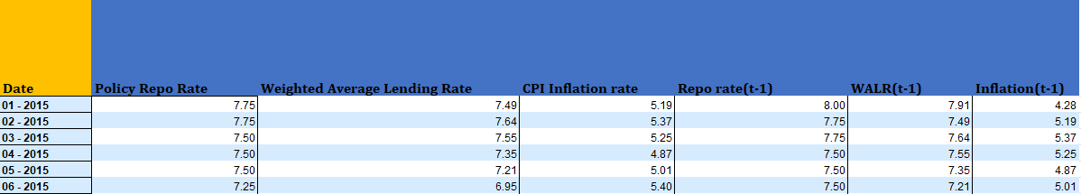
Data and Sources
Creation of lag variables:
Lagged Repo Rate
Lagged WALR
Dataset structured to enable regression and forecasting in Excel.

Slide 8
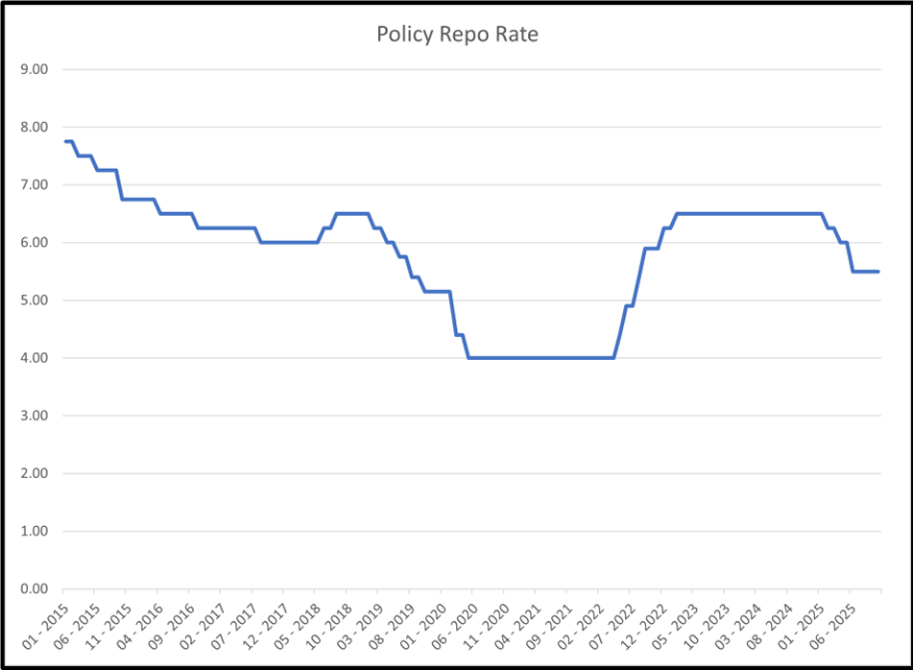
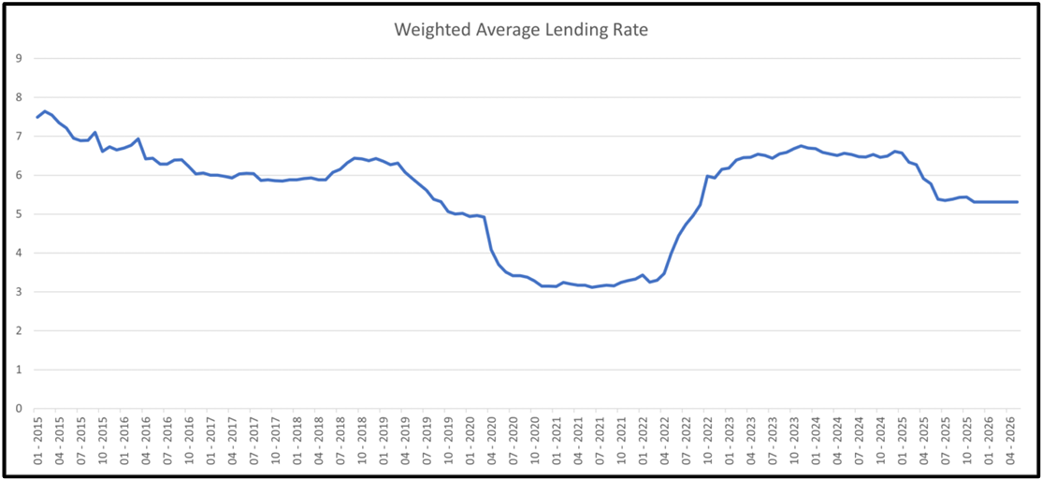
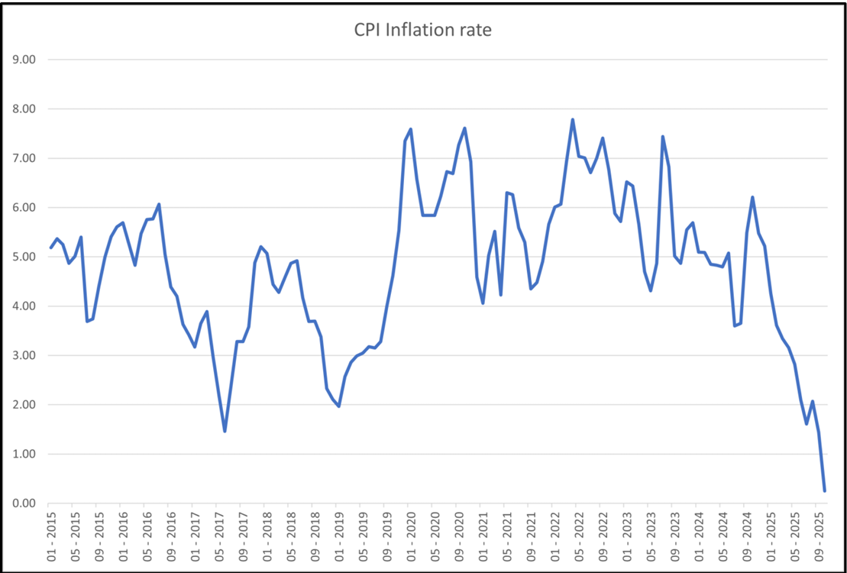
Graphical Representation of data

Slide 9



Econometric Models
The empirical strategy involves estimating a sequence of regression models to trace the monetary transmission mechanism. First, a simple linear regression is estimated to examine the contemporaneous impact of the repo rate on WALR:
Second, a lagged regression model is estimated to capture delayed transmission from the repo rate to lending rates:
Third, a multivariate regression model incorporating both current and lagged repo rates is estimated to distinguish between immediate and delayed effects:
Finally, the transmission from lending rates to inflation is examined using a lagged regression model:

Slide 10
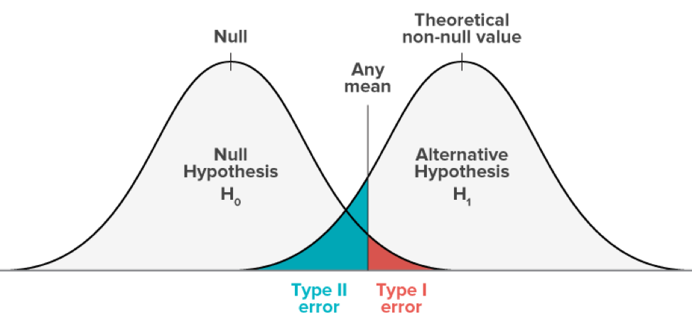
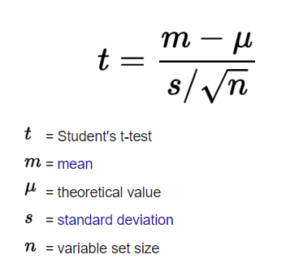
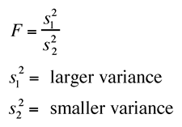
Hypothesis Testing
For each regression model, null and alternative hypotheses are formulated. The statistical significance of coefficients is tested using:
t-statistics for individual variables
F-statistics for overall model significance
A 5% significance level is used as the decision criterion. If the p-value is less than 0.05, the null hypothesis is rejected.
The null hypothesis in each case states that the relevant slope coefficient is equal to zero, implying no transmission effect.
The alternative hypothesis states that the coefficient is statistically different from zero.

Slide 11
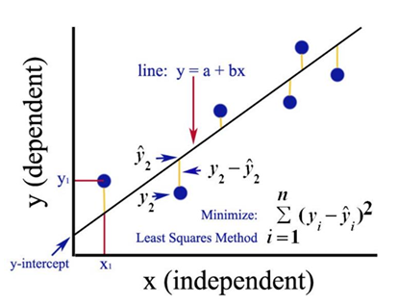

Ordinary Least Squares (OLS)
Ordinary Least Squares (OLS) is an econometric method used to estimate linear relationships between variables
It determines regression coefficients by minimizing the sum of squared residuals.
Residuals represent the difference between actual and predicted values
Y: Dependent variable (WALR / Inflation)
X: Independent variable (Repo Rate / Lagged WALR)
Provides unbiased and efficient estimates
Allows hypothesis testing using t-tests and F-tests
Regression analysis, hypothesis testing, and residual diagnostics are implemented using the Data Analysis ToolPak in Microsoft Excel.

Slide 12
REGRESSION ANALYSIS

Slide 13



MODEL 1 - Repo Rate and WALR (Contemporaneous Model)
This model examines the immediate or contemporaneous impact of the policy repo rate on bank lending rates.
The dependent variable, WALR, represents the average lending rate charged by banks, while the repo rate captures the stance of monetary policy.
The coefficient α1 measures the extent of interest rate pass-through from the policy rate to lending rates within the same period.
Null Hypothesis (H₀₂): The lagged repo rate does not significantly affect the current Weighted Average Lending Rate.
Alternative Hypothesis (H₁₂): The lagged repo rate significantly affects the current Weighted Average Lending Rate.

Slide 14
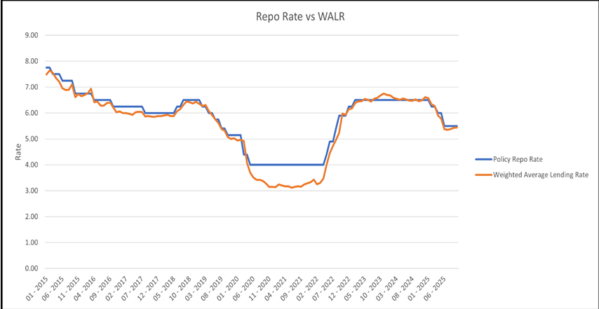
MODEL 1 - Repo Rate and WALR (Contemporaneous Model)

Slide 15
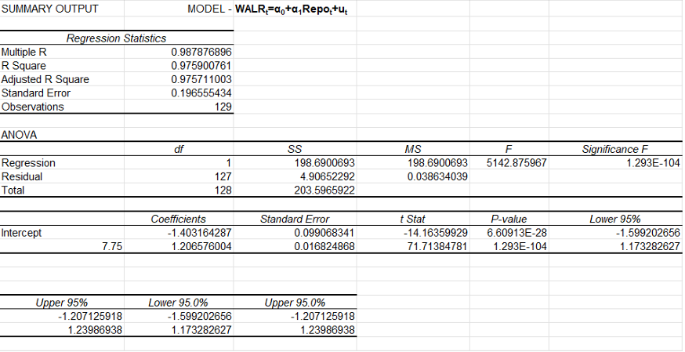
Regression analysis using excel

Slide 16
Key Findings of Model 1
The Multiple R value of 0.988 indicates an extremely strong positive linear relationship between the policy repo rate and the Weighted Average Lending Rate (WALR).
The R² value of 0.976 implies that approximately 97.6% of the variation in WALR is explained by changes in the repo rate.
The F-statistic (5142.88) is extremely high. The corresponding Significance F (1.29 × 10⁻¹⁰⁴) is far below the 1% significance level. This confirms that the model is statistically significant as a whole and that the repo rate is a meaningful predictor of WALR.
The estimated slope coefficient for the repo rate is 1.206. This implies that a 1 percentage point increase in the repo rate leads to an average increase of about 1.21 percentage points in WALR.
Since lending rates respond strongly to changes in the repo rate, monetary policy actions by the Reserve Bank of India are likely to influence borrowing costs in the economy. This strengthens the central bank’s ability to manage demand conditions through interest rate adjustments.

Slide 17



Model 2- Lagged Repo Rate and WALR (Delayed Transmission Model)
This model captures the delayed effect of monetary policy on lending rates by introducing a one-period lag of the repo rate.
The coefficient β1 measures how past policy decisions influence current lending rates.
A statistically significant β1 provides evidence of persistence in monetary transmission and confirms that policy rate changes continue to affect lending rates beyond the period in which they are announced.
Null Hypothesis (H₀₂): The lagged repo rate does not significantly affect the current Weighted Average Lending Rate.
Alternative Hypothesis (H₁₂):
The lagged repo rate significantly affects the current Weighted Average Lending Rate.

Slide 18
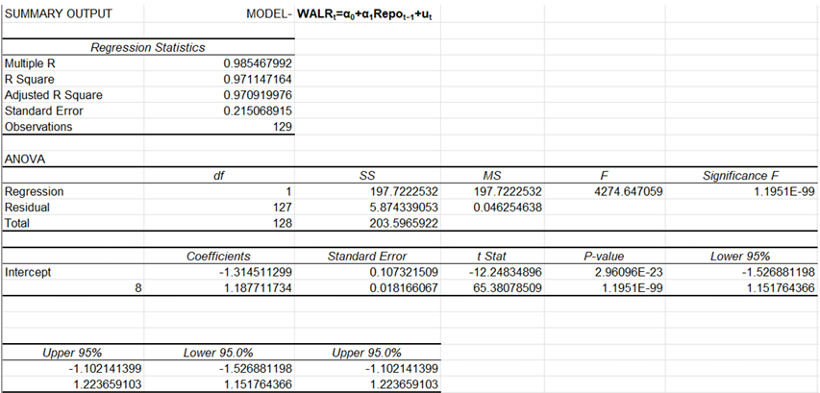
ANOVA and regression Analysis

Slide 19
Key Points and Findings
The Multiple R value of 0.985 indicates a very strong positive relationship between the lagged repo rate and the current WALR.
The R² value of 0.971 suggests that about 97.1% of the variation in WALR is explained by the repo rate of the previous period.
The F-statistic (4274.65) is very large, indicating strong overall model fit.
Compared to the contemporaneous model, the lagged model shows:
Slightly lower R²
Similar coefficient magnitude
Continued high statistical significance
This implies that repo rate changes affect WALR both immediately and with a lag, suggesting a mixed transmission pattern.
The presence of a strong lagged effect suggests that monetary policy actions have persistent effects on lending rates. Policymakers should account for delayed transmission when evaluating the impact of interest rate decisions on credit conditions.

Slide 20

Model 3- Current and Lagged Repo Rates with WALR (Dynamic Model)
This model integrates both contemporaneous and lagged repo rates to analyze the dynamic adjustment process of lending rates.
The coefficient γ1 captures the immediate response of WALR to changes in the repo rate, while γ2 measures the delayed adjustment effect.
The joint significance of both coefficients indicates that monetary policy transmission operates through both immediate and lagged channels.
Null Hypothesis (H₀₃): Current and lagged repo rates jointly have no significant effect on WALR.
Alternative Hypothesis (H₁₃): At least one of the current or lagged repo rate coefficients significantly affects WALR.

Slide 21
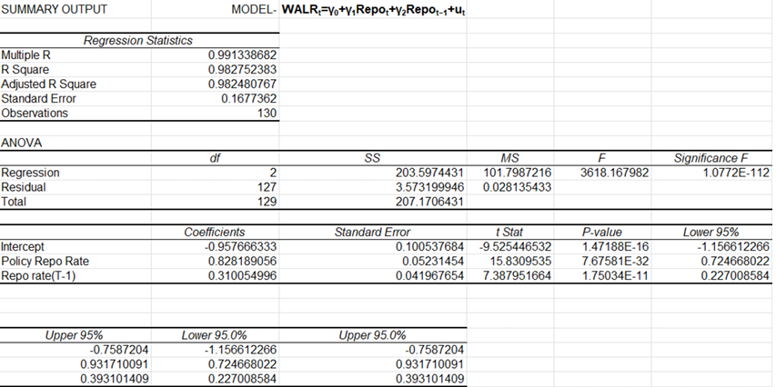
ANOVA and Regression Analysis

Slide 22
Key Points and Findings
The Multiple R value of 0.991 indicates an exceptionally strong relationship between WALR and the explanatory variables.
The R² value of 0.983 implies that 98.3% of the variation in WALR is jointly explained by the current and lagged repo rates.
The coefficient on the current repo rate (γ₁ = 0.828) is positive and highly significant (p value ≈ 7.68 × 10⁻³²).
The coefficient on the lagged repo rate (γ₂ = 0.310) is also positive and statistically significant (p-value ≈ 1.75 × 10⁻¹¹).
The long-run (cumulative) pass-through is given by the sum of coefficients:
The presence of both significant contemporaneous and lagged effects implies that lending rates adjust gradually rather than instantaneously.
Monetary policy actions by the RBI influence lending rates both immediately and over subsequent periods.

Slide 23


Model 4 - Lagged WALR and Inflation (Price Transmission Model)
This model examines the final stage of the transmission mechanism by analyzing the impact of lending rates on inflation.
Inflation is the dependent variable, while lagged WALR captures borrowing costs faced by households and firms in the previous period.
A negative and statistically significant δ1 supports the theoretical prediction that higher lending rates reduce inflation by curbing aggregate demand.
Although the explanatory power of this model is relatively modest, this is expected in an economy where inflation is influenced by multiple non-monetary factors.
Null Hypothesis (H₀₄):
Lagged Weighted Average Lending Rate has no significant effect on inflation.
Alternative Hypothesis (H₁₄):
Lagged Weighted Average Lending Rate has a significant effect on inflation.

Slide 24
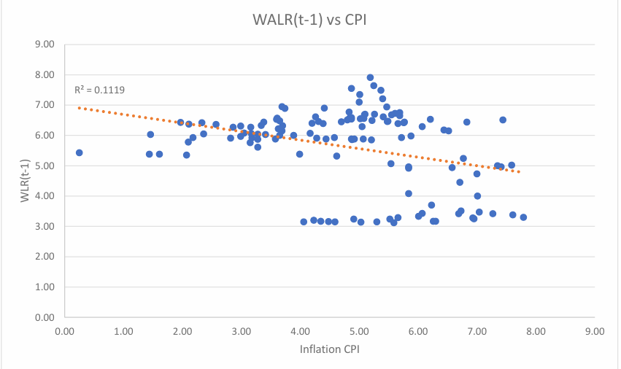
Graph Showing Correlation between WALR(t-1) and CPI

Slide 25
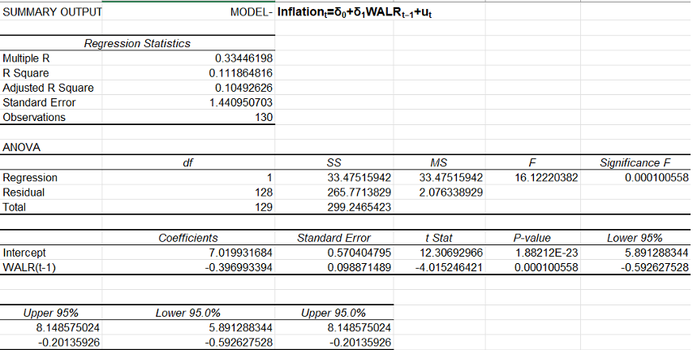
ANOVA and Regression Analysis

Slide 26
Key Points and Findings
The F-statistic (16.12) with a Significance F of 0.00010 indicates that the model is statistically significant.
The R² value of 0.112 suggests that approximately 11.2% of the variation in inflation is explained by changes in WALR in the previous period.
The coefficient on WALRₜ₋₁ is –0.397, which is statistically significant at the 1% level.
This implies that a 1 percentage point increase in lending rates in the previous period reduces inflation by about 0.40 percentage points in the current period.
The t-statistic (–4.02) and p-value (0.00010) strongly reject the null hypothesis that the coefficient on WALRₜ₋₁ is zero.
The significance of WALRₜ₋₁ (rather than WALRₜ) suggests that monetary policy affects inflation with a time lag.
This aligns with monetary theory, which predicts that interest rate changes influence inflation gradually through consumption and investment channels.

Slide 27
Key Points and Findings
Role of Non-Monetary Factors The low R² highlights that inflation in India is influenced by several non-monetary factors such as:
Supply-side shocks (food and fuel prices)
Global commodity prices
Fiscal policy and administered prices
Lending rates form only one component of the broader inflation process.
The results indicate that tightening lending conditions can help moderate inflation, but interest rate policy alone is insufficient to fully control inflation.
Coordinated policy measures addressing supply constraints are necessary for effective inflation management.
Combined with earlier results, this model completes the transmission mechanism: Repo Rate → WALR → Inflation

Slide 28
Limitations of the Study
The study considers only a limited number of variables—repo rate, Weighted Average Lending Rate (WALR), and inflation—while other macroeconomic factors such as exchange rate, money supply, fiscal policy, and global commodity prices are excluded.
The analysis is based on aggregate monthly data, which may conceal sector-wise or bank-wise differences in interest rate pass-through behaviour.
The regression models used are linear in nature, which limits the ability to capture non linear or asymmetric responses of lending rates and inflation to policy changes.
Possible structural breaks arising from major economic events (such as policy regime shifts or the COVID-19 pandemic) are not explicitly modeled.
The forecasting exercise is restricted to a short time horizon due to the unavailability of future values of explanatory variables.

Slide 29
CONCLUSION
The study analyzes monetary policy transmission in India using econometric regression and data visualization techniques.
Results confirm a significant pass-through from the RBI’s repo rate to bank lending rates (WALR).
Both contemporaneous and lagged effects of the repo rate on lending rates are observed, indicating transmission delays.
Changes in lending rates are found to impact inflation with a time lag, consistent with economic theory.
Hypothesis testing supports rejection of the null hypotheses across key regression models.
The regression models demonstrate satisfactory explanatory power, validating the chosen methodology.
Data visualization aids in understanding trends, relationships, and dynamic responses.
Overall, the interest rate channel is shown to be an effective tool of monetary policy in India, though adjustments occur gradually over time.

